Slide 1
XTrace
Secure AI Agent Knowledge and Memory Protocol
Notes:
Hi everyone, I’m Felix Meng, the CEO and founder of XTrace. I’d like to extend a big thank you to Encode Club for inviting me, and to all of you for being here today. I’m excited to introduce XTrace, a platform designed for secure AI agent knowledge sharing and collaboration. As we all know, AI is transforming the world at an incredible pace, and I believe as how as . Let’s dive in and get started!

Slide 2
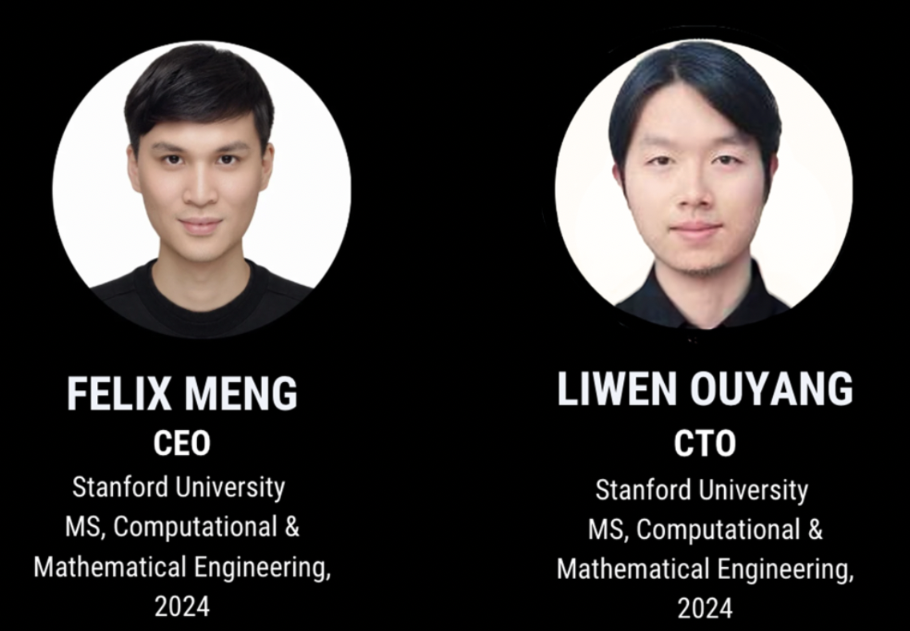
XTrace Founders

Slide 3
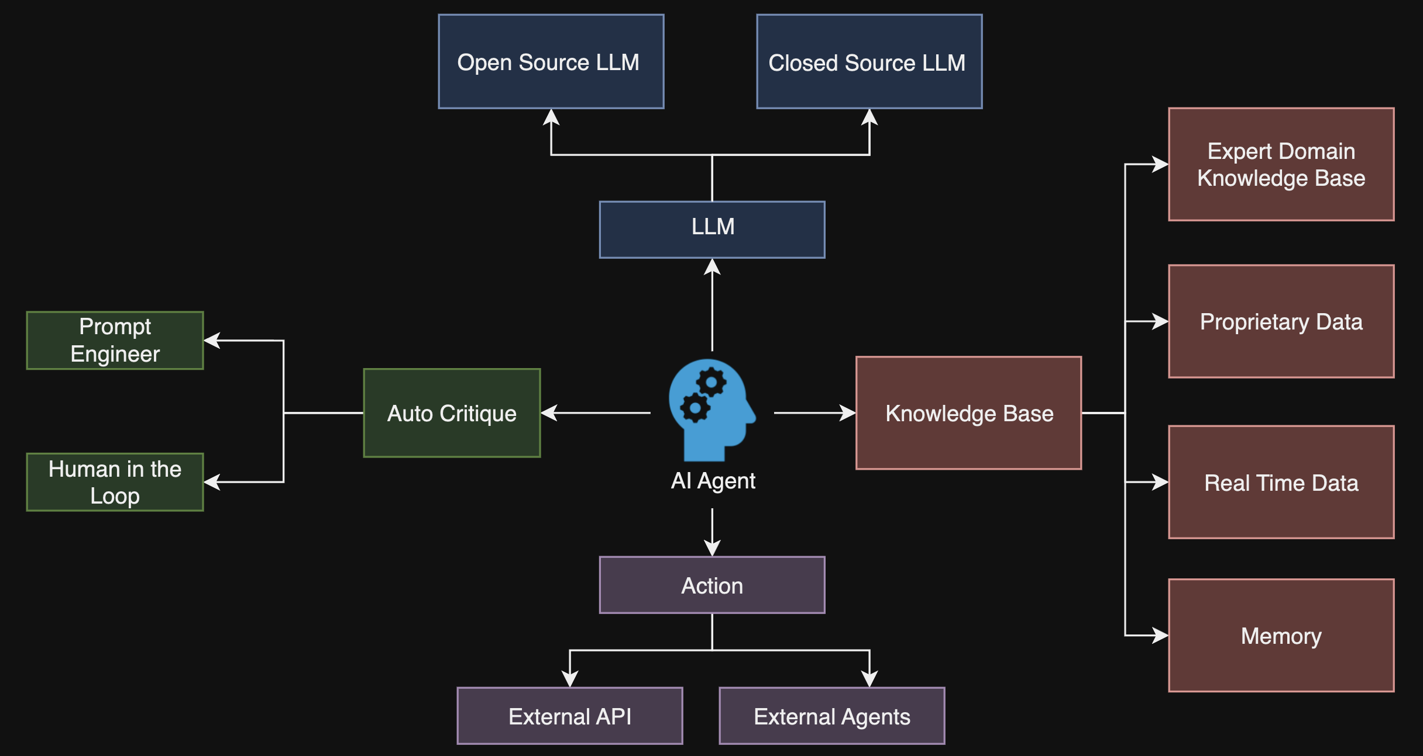
AI Agent Defined
A software program combining LLMs, with memory, tools, and self-critiquing algorithms to autonomously learn and perform tasks

Slide 4
Problem
AI agents need access to proprietary data but can't sign NDAs, limiting cross-company collaboration
AI agents cannot retain or transfer learned experiences across systems, limiting continuity and personalization.
Lack of stateful AI agents, particularly in multi-agent environments

Slide 5
Solution
Privacy-Preserving Vector Database: Securely stores proprietary, real-time, and domain-specific data for millisecond-level privacy-preserving RAG
XTrace Sharable Portable Memory System: Manages personalized user information and AI agent experiences securely
Secure Multi-Agent Collaboration: Enables stateful, secure collaboration with collaborative memory accessible only to authorized agents.

Slide 6
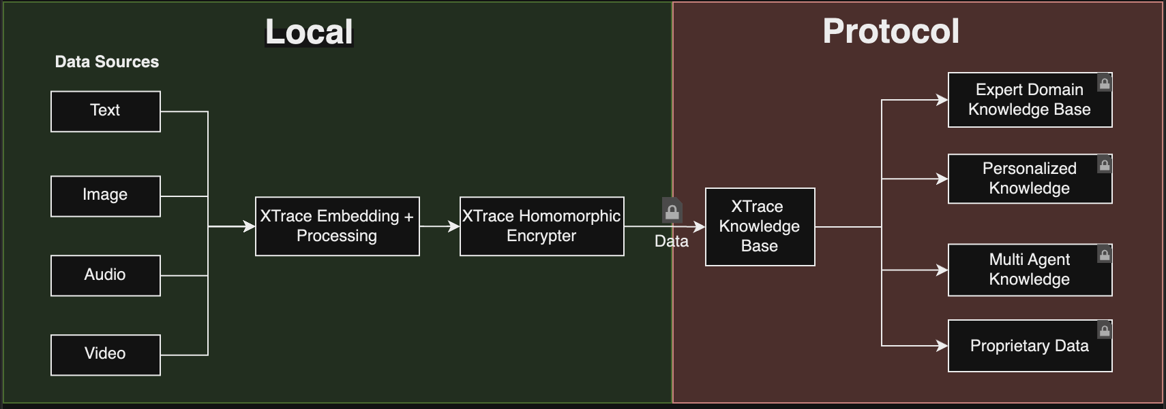
XTrace Solution: Encrypted Knowledge Base
Securely organize and store your company's fragmented structured and unstructured data into a centralized, private knowledge base. These enhanced databases enrich, contextualize, and synthesize your data, enabling smarter, more dynamic access compared to traditional databases.

Slide 7
XTrace Privacy Preserving AI Agent
Notes:
Benefits:
AI Agents can do Semantic Search Without Revealing Query
All Data in the database can stay encrypted
XTrace serves as intermediary while not knowing query and result
Bypass training and allow agents have instant access to required knowledge

Slide 8
XTrace Memory System
Cost Efficiency: LRU-inspired hierarchical system optimizes memory management for lower costs.
Continuous Improvement: Agents leverage past experiences to enhance long-term performance.
Private Portable and Sharable: Encrypted memory with modular, user-defined access control for secure collaboration.

Slide 9
XTrace Stateful Multi Agent Collaboration
Each XTrace agent is equipped with access to its own memory and dedicated knowledge base.
XTrace retains all past interactions between agents, enabling stateful, multi-agent collaboration.
Multi-agent groups learn and improve collectively, leveraging shared experiences over time.

Slide 10
XTrace Universal Knowledge Network
Agents can share knowledge in the XTrace Universal Knowledge Network.
New agents inherit the collective experience of all XTrace agents.
Infinite Scalable Knowledge minimizes computation costs for previously learned information
Agent owners earn revenue whenever their agent’s past experiences are utilized.
Notes:
Each XTrace agent that joins the network will instantly inherit publicly shared experience and knowledge from previous interactions.

Slide 11
Thank you!
XTrace

